Slide 1
RAJDOOT CABLES PRIVATE LIMITED
Manufacturers in India in the domain of indigenous electrical wires and cables of varied range in Enameled & polymers material both in copper & aluminum conductor along with Electrical Accessories Mono block Pump , Electric Motor ,Pipes in Conduit & flexible with fittings , PVC Tapes ,IRON , Extensions with Three Pin Attachments , BULB Holder , FANS ,BAKELITE Sheets , BLENDER , GEYSER , HEATING ELEMENTS Etc. since 1979
Welcome

Slide 2
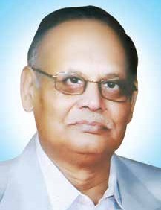
Chairman
First of above all I would like to express my thanks to all of my dealers, distributors and cooperators... that have been bound to the evolving Rajdoot Cables success story. Without your unflinching support and hard work we could not have achieved this position. The support and hard work of many people have made this possible. I would like to thank each and everyone for their love and support.
Starting my career with a Govt. Job, I had all along believed at the bottom of my heart, that I could do something good in the cable business and therefore in 1979, I decided to get into the business.
SH. V.P. GOYAL (Chairman)

Slide 3
Organisation Chart
VP Goyal
Chairman
Himanshu Goyal
Managing Director
Sohan Singh
Quality Head & Development
Johan Parker
Head – Manufacturing & Development
HR Head
Vaccant
Aryan Chauhan
GM- BH & operations
Finance Head
Vaccant
Karan Pal
Marketing Manager
Manju
Tendering
Rajesh Sharma
House Wire Sr. Executive
Sundar Singh
House wire Executive
Brijmohan
Production Manager
Pawan Singh
Sr. Engg. QMS
Hari Om
Hr Executive
Sudhansu Goyal
Director
Customer comp .
Engg.
Shift Incharge
Honey Shukla
Accountant
Purchase Head
Vaccant
Costing Executive
Payment reconcillation and Ammendment
Vaccant Marketing executive-Automobile
Vaccant In process Engg
Purchase Executive
Store Incharge
Maintenance Head
Heera Lal
Maint. Supervisor
Electrician & mechanical

Slide 4
Rajdoot Cables Policy
Company Vision
Quality Policy
We at Rajdoot Cables Pvt .Ltd. manufacturer of Complete Electrical solutions are committed to achieve excellence in customer satisfaction By ensuring Quality Quantity ,Reliability and Timely Delivery through continual improvement and active participation of all employees ’quality management system as well as by fulfilling applicable statutory and regulatory requirements.
To be a highly reliable solution provided for '‘Complete electrical system" for the auto motive and Metro –power , Home Appliances sector etc. industry adding value through innovation process excellence for the manufacture customized and competitive products to ensure customer delight and achieve 500 m INR by 2027
Our Mission
To be a partner of ''first choice" with all our customers by driving industry and customer needs
*To be a ''corporate citizen" as focused initiatives towards environment and community development.
Revenue will be increase YOY 50%.
Entry in New Segment & Add New Customers.

Slide 5
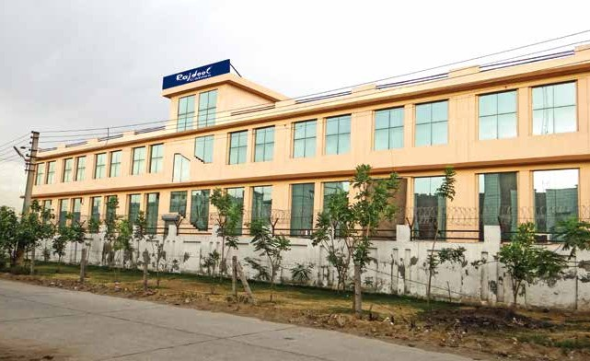
Covered Area : 72000 sq. ft.
RAJDOOT CABLES PRIVATE LIMITED
Branch Office: 121/C,NIT Faridabad, Haryana-121001
Head Office: Plot No.- 127-128, Sector- 59, Phase - II, Industrial Area HUDA. Ballabhgarh, Faridabad(HR)- 121004

Slide 6
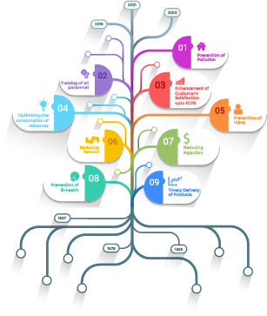
History of Rajdoot Cables
RAJDOOT CABLES
was
established in the year 1979. Today,
It is one
of the pioneer in India in the
manufacturers
domain of indigenous COMPLETE ELECTRICAL SYSTEM of varied range both in copper and aluminum conductor. Rajdoot Cables having a 2 manufacturing unit in Ballabhgarh, Faridabad (Haryana) in a covered area of 72000 sq.ft. engaged with a team of highly motivated, educated and well experienced engineer and technical personnel.

Slide 7
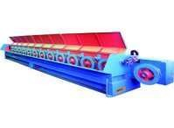
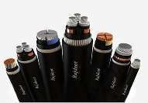
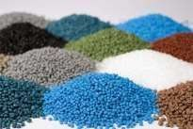
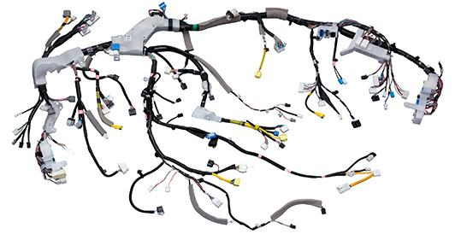
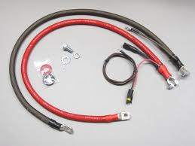
Back Up Integration
Copper and aluminium Drawing
Power cables and cords
Engineering
PVC compounding
WIRE
HARNRSS
Battery cable

Slide 8
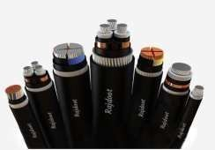
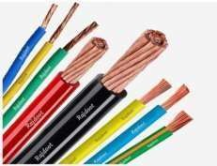
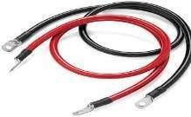
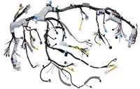

Slide 9
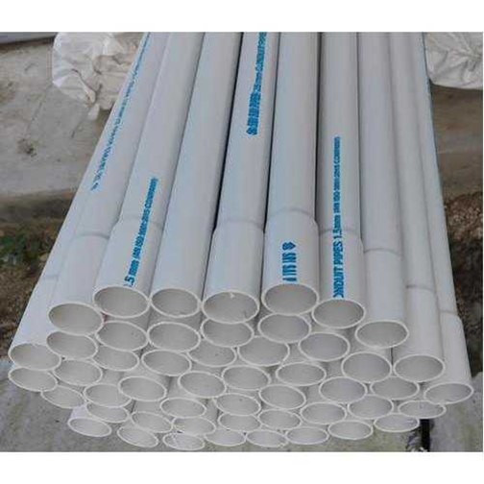
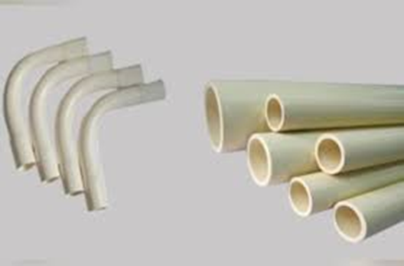
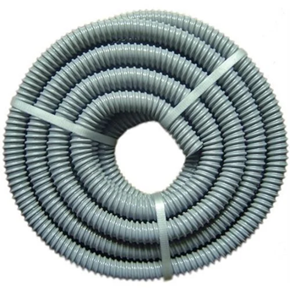
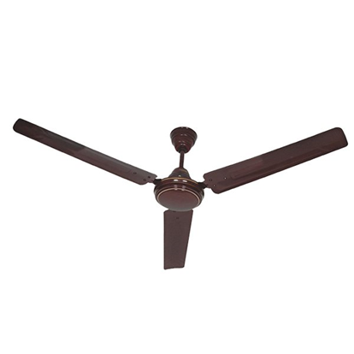
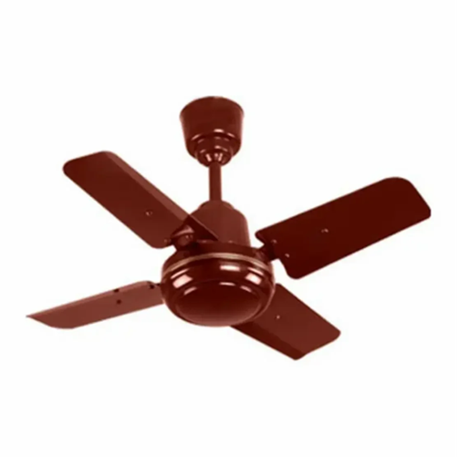
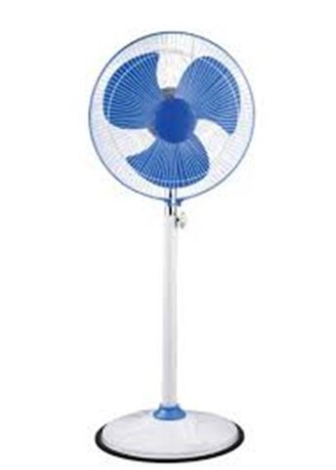
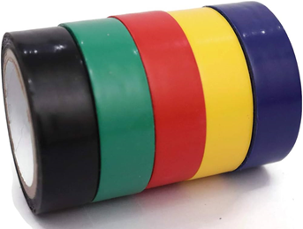
PRODUCT

Slide 10
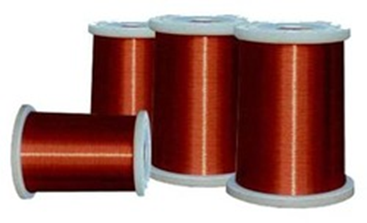
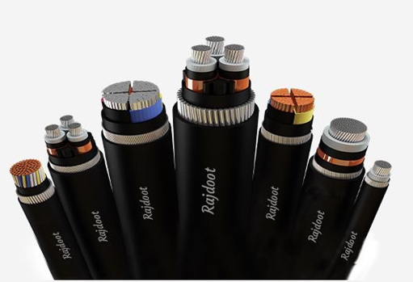
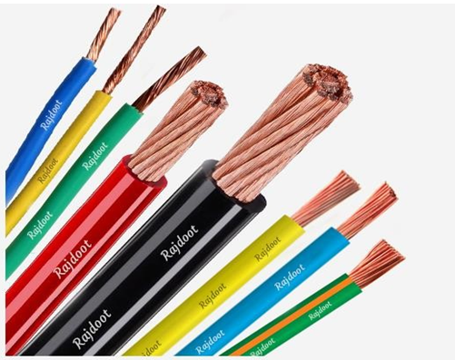
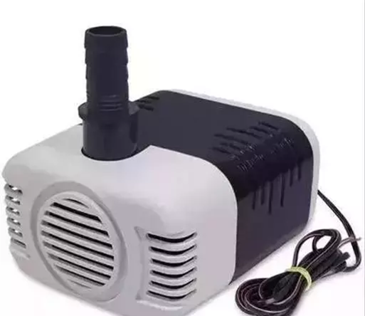
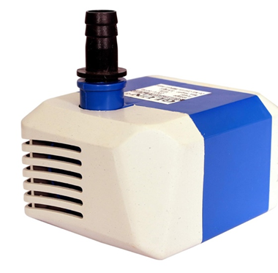
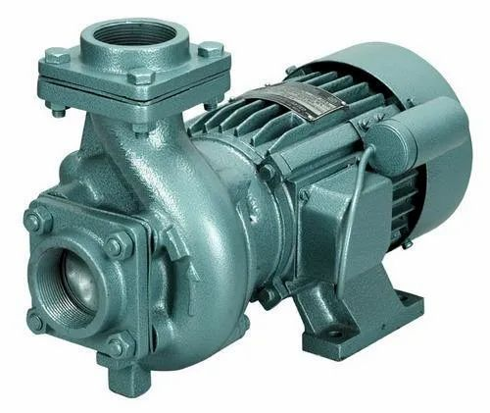
PRODUCT

Slide 11
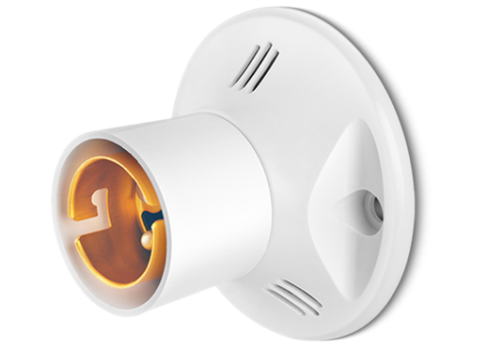
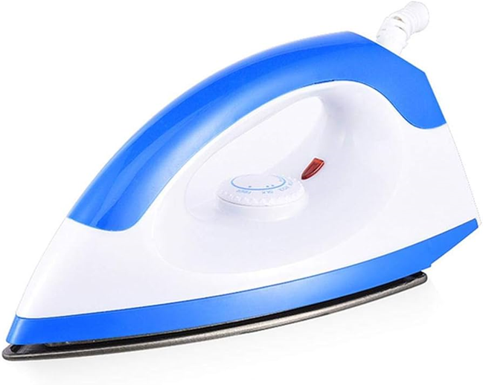
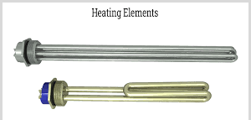
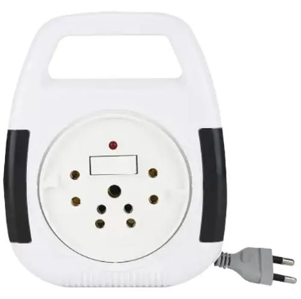
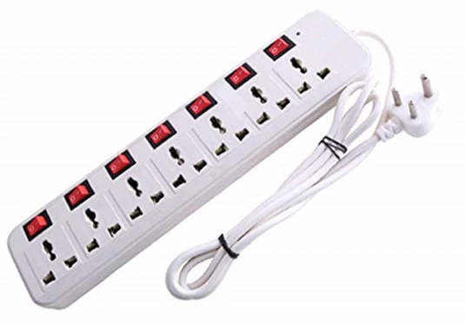
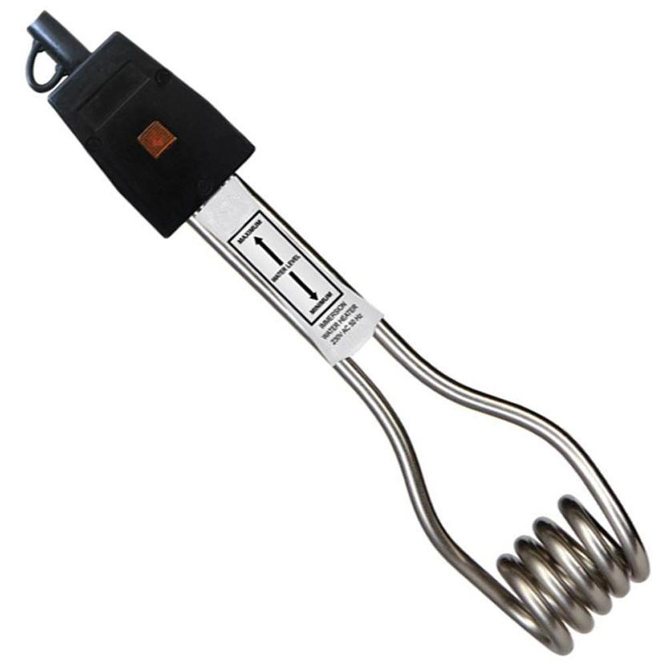
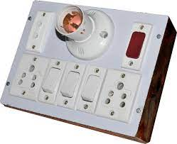
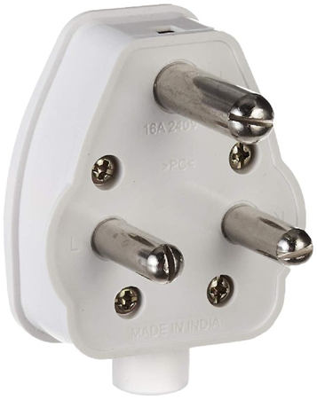
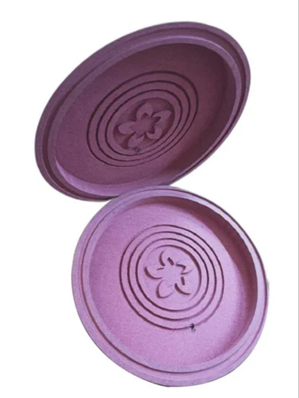
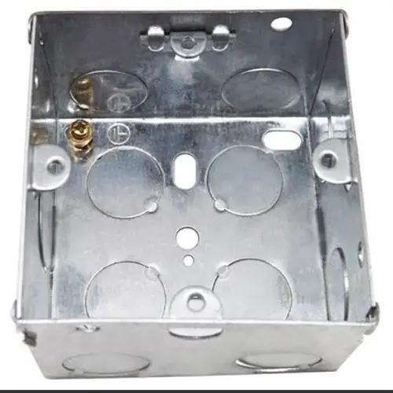
Home Appliances Product

Slide 12
WHY RAJDOOT WIRES & CABLES ARE BETTER
"RAJDOOT" provide some of the highest levels of electrical conductivity i.e.101% copper conductivity which means reduction in electricity bills -2 to -3%.
Drop in voltage from point of supply to the end-terminal is called voltage drop. High voltage drop across conductors is undesirable as it reduces the supplied energy.
Due to low conductor resistance, current carrying capacity is more.
Fire caused due to short circuit is the most common electrical mishap. Short circuit can be caused by most of reasons such as faulty wiring.
100% wires pass through spark tester to withstand high voltage stresses of 9000 Volts to give consistent quality, free of foreign particles throughout.
Di-electric strength represents the magnitude of voltage endured by test-piece of wire when a specified voltage is passed through it for a specified duration of time.
Thin colored layer is only on the surface for color identification. Thick layer of natural virgin PVC is underneath which gives improved resistance value.
In case of electrical insulation, damages caused by pests may lead to short circuit which can become a cause for a major disaster, loss of human life.

Slide 13
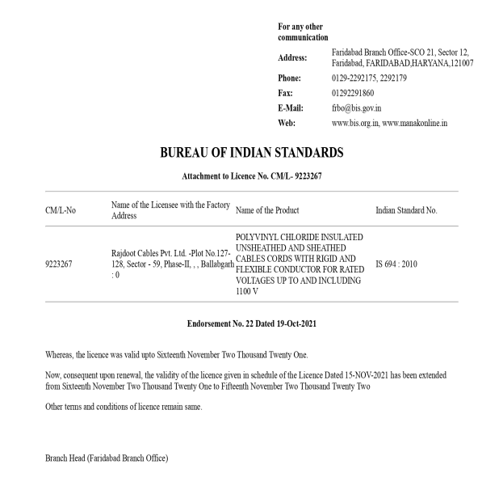
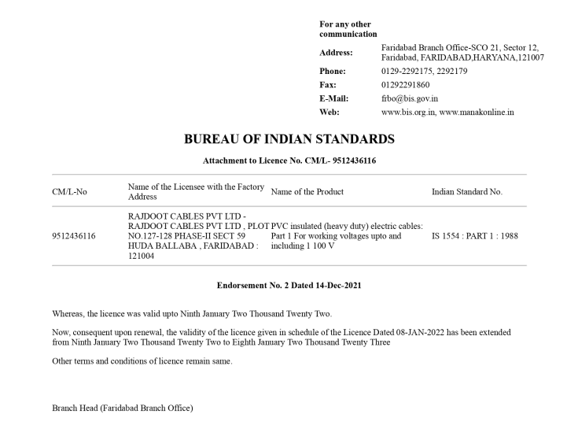
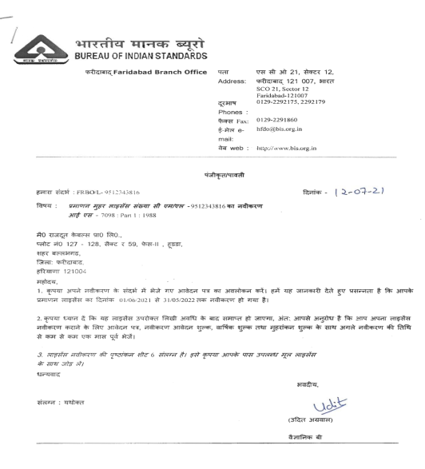
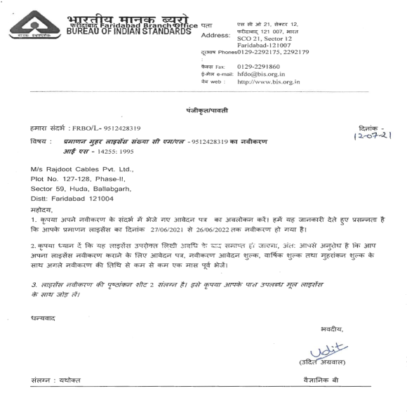
Indian Standards with Licenses
IS:694 / 2010
IS:1554 / P-I / 1988
IS:7098 / P-I / 1988
IS:14255 / 1995
S.No. | Indian Standards | Voltage Grade | Application
01 | IS:694 / 2010 | 1.1 KV | For House wiring cables, Industrial wiring cables, PVC insulated flexibles (single & multicore).
02 | IS:1554 / P-I / 1988 | 1.1 KV | For PVC single / multicore cables, armoured and unarmoured upto 630 sq. mm.
03 | IS:7098 / P-I / 1988 | 1.1 KV | LT XLPE power cables (upto 4 core x 630 sq.mm., 1core x 1000 sq.mm.)
04 | IS:14255 / 1995 | 1.1 KV | Aerial Bunched Cables
05 | UL Certification | 1015,3266,3271 | Under Approval till Dec 2022

Slide 14
OUR SOURCE FOR RAW MATERIALS
Sr. No. | RAW MATERIALS | SOURCE
A | COPPER | BIRLA COPPER / STERITE INDUSTRIES/ HINDALCO
B | ALUMINUM | HINDALCO/VEDANTA
C | P.V.C. | TAKKAR INDUSTRIES / SHRI RAM VINYL / RELIANCE
D | XLPE | KLJ / KALPANA

Slide 15
MAJOR CLIENTS

Slide 16
APPROVALS
Besides approvals by leading electrical consultants and architects our products are approved by the following.
Sr. No. | Department | Sr. No. | Department
01. | DHBVN | 07. | INDIAN RAILWAYS
02. | UHBVN | 08. | HPSEBL
03. | HVPNL | 09. | SAIL
04. | DVVNL | 10. | REIL
05. | JBVVNL | 11. | TATA PROJECTS
06. | JVVNL | 12. | IOCL

Slide 17
LIST OF MACHINERY
Sl.No. | Machinery | Make | Capacity | Number | Remarks
01 | 40 + 25 mm Extruder | Prem Eng | 80 kg/h. | 01 | PVC Ins.
02 | 25 kg PVC Mixer | Prem Eng | 25 kg – 15 min . | 01 | PVC Mixing
03 | 65 + 35 mm Extruder with Hooper | Bagal Eng | 125 kg/h. | 01 | XLPE/PVC Ins.
04 | 50 kg PVC Mixer | Prem Eng | 50 kg – 15 min . | 01 | PVC Mixing
05 | 52 + 35 mm Extruder with Hooper | Prem Eng | 110 kg/h | 01 | PVC Ins.
06 | 25 kg PVC Mixer | Prem Eng | 25 kg – 15 min . | 01 | PVC Mixing
07 | 80 + 45 mm Extruder | BSS Eng | 200 kg/h | 01 | XLPE Ins. & PVC Sheathed
08 | 50 kg PVC Mixer | Sohan Lal | 50 kg – 15 min . | 01 | PVC Mixing
09 | 120 mm Extruder | BSS Eng | 350 kg/h | 01 | XLPE Ins. & PVC Sheathed
10 | 37 Bobbin Stranding Machine | Sharma Eng | 500 m/h | 01 | Stranding
11 | 7 Bobbin Tubler Machine | Sharma Eng | 1000 m/h | 01 | Stranding
12 | Laying Machine (12 Heads) | Batshal Eng | 3000 m/h | 01 | Core laying & Conductor stranding
13 | Twisting Machine (12 Heads) | Batshal Eng | 5000 m/h | 01 | Core Laying
14 | Laying cum Armouring Machine | Batshal Eng | 2000 m /h | 01 | Core Laying & Armouring

Slide 18
LIST OF MACHINERY
Sl.No. | Machinery | Make | Capacity | Number | Remarks
15 | 7 Bobbin Stranding Machine | Sharma Eng | 2000 m /h | 01 | Conductor Stranding
16 | Double Head Coiling Machine | Prem Eng | 100 Coil / h | 01 | Rewinding & Coiling
17 | Double Head Coiling Machine | Prem Eng | 100 Coil / h | 01 | Rewinding & Coiling
18 | Auto Coiling | Minimax | 200 Coil / h | 01 | Coiling
19 | Double Head Coiling Machine | Prem Eng | 100 Coil / h | 01 | Rewinding & Coiling
20 | 95 mm Compounding Extruder | Sohan Lal | 150 kg / h | 01 | PVC Compounding
21 | 50 KG PVC Compounding mixer | Sohan Lal | 200 kg / h | 01 | Compound mixing
22 | HI- speed Drawing Machine | DC Eng | 100 kg / h | 01 | Al/Cu Drawing
23 | Rod Drawing Machine | DC Eng | 300 kg/h | 01 | Al/Cu Drawing
24 | Intermediate Drawing Machine | DC Eng | 250 kg/h | 01 | Al/Cu Drawing
25 | Annealing pot | DC Eng | 1000 kg/day | 01 | Al/Cu Annealing
26 | 16 Head Annealing Machine | DC Eng | 100 kg/h | 01 | Copper Annealing
27 | 14 Head Annealing Machine | DC Eng | 80 kg/h | 01 | Copper Annealing
28 | Bunching Machine (400 mm) | Hind Fab | 4000 m/ h | 01 | Conductor Stranding

Slide 19
LIST OF MACHINERY
Sl.No. | Machinery | Make | Capacity | Number | Remarks
29 | Bunching Machine (500 mm) | Minimax | 5000 m/h | 01 | Conductor Stranding
30 | Breezing Machine | Weltech | Nil | 01 | Conductor Jointing
31 | Tinning Machine | DC Eng | 100 kg/h | 01 | Copper Tining
32 | Air Compressor 5 Hp | Gravitas | 5 Hp | 01
33 | DG Set 40 kVA | Kiloskar | 40 kVA | 01
34 | DG Set 125 kVA | Cumins | 125 kVA | 01
35 | DG Set 140 kVA | Cumins | 140 kVA | 01
36 | Dies and nozzles | available | List attached | 01

Slide 20
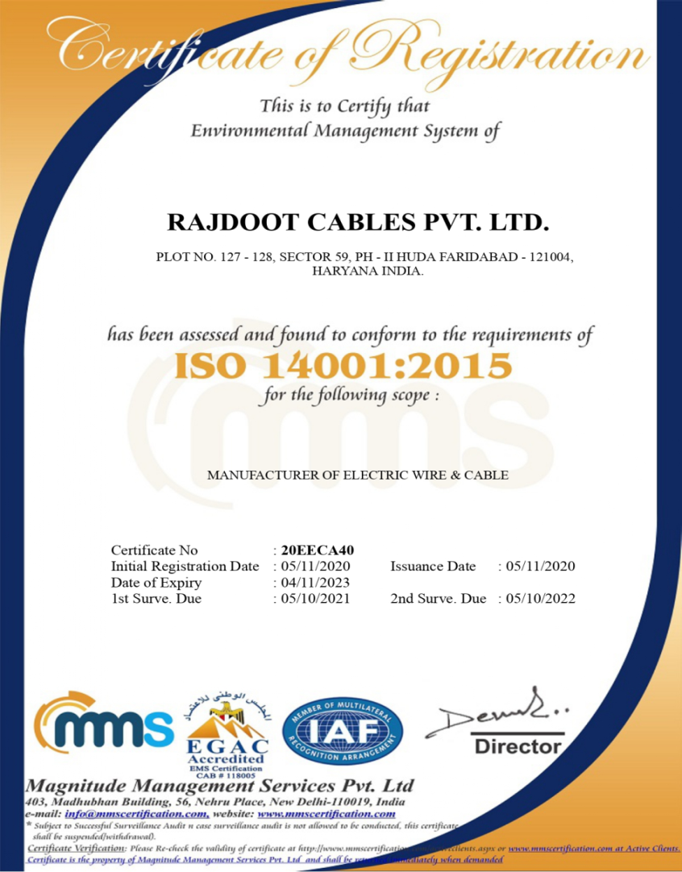
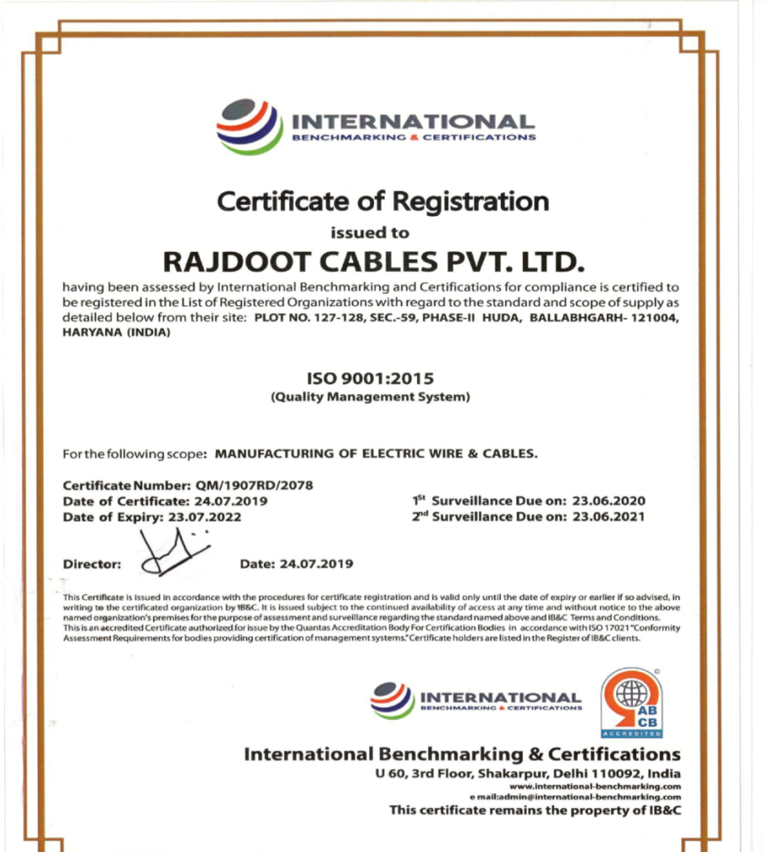
CERTIFICATIONS

Slide 21
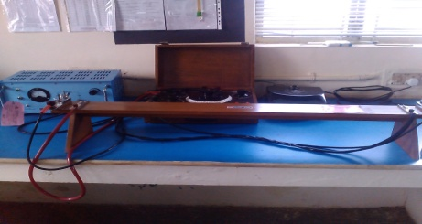
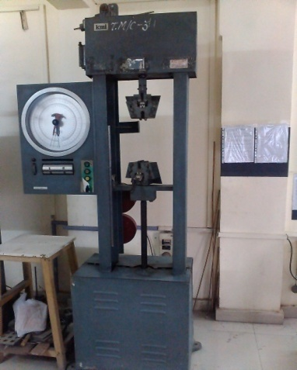
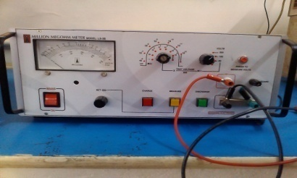
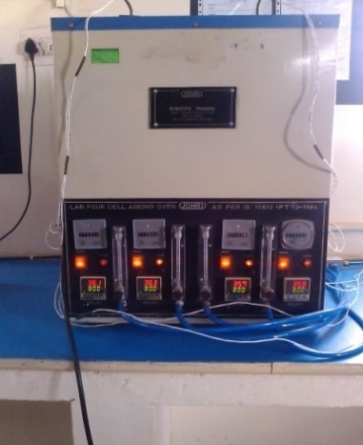
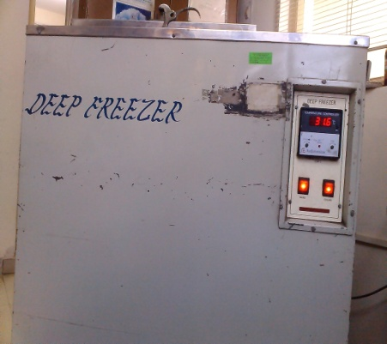
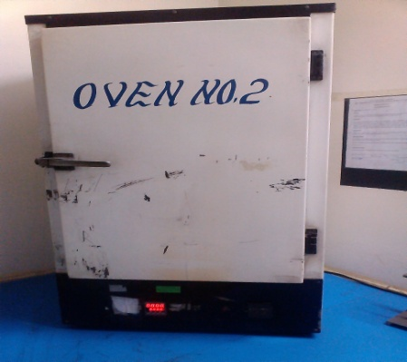
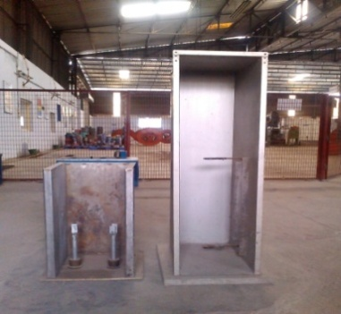
TESTING EQUIPENTS
High Voltage Test
(Water Immersion)
KELVIN BRIDGE ( C. R)
INSULATION TESTER
TENSILE STRENGTH
AGEING AIR OVEN
LOW TEMPERATURE ( D. FREEZER)
HEATING ( OVEN)
FLAMMABILITY TEST

Slide 22
TECHNOLOGY UPGRADATION
Technology Up gradation - Technical Ventures / Joint Venture for wiring harness/BC-Battery Cables.
Introduction to Key Account Manager
Global Potential Research Report
Global Business Strategy Jointly
Quarterly Report
1
2
Continuous Tracking System
Monthly Progress Report
Identification of Right Partners
Quarterly Report
Updating About Global Digital Trade Fairs
Quarterly Report
3
Sharing Documents & Related Information
Arranging Audio / Video Conference call
Nurturing Prospects
Techno Commercial Exchange
Quarterly Report
4
Organizing Visits
Organizing Round of Discussions
Defining Business Terms
Initiating MOU/ Agreement
5

Slide 23
THANKYOU
Address E-mail Number Website
Plot No.- 127-128, Sector- 59, Phase - II, Industrial Area HUDA. Ballabhgarh, Faridabad(HR)- 121004,
sales@rajdootcables.com
rajdootcables@yahoo.co.in
aryan@rajdootcables.com
Tel. No.- 0129- 4165087,
Ph. No.: +91-9289309609
www.rajdootcables.com

